Slide 1
Homework 2
- Wolfgang Karl Härdle
- Ying-Yu Chen

Slide 2
Outlines
HW2：Scatterplot of New Taipei City’s bike dataset

Slide 3
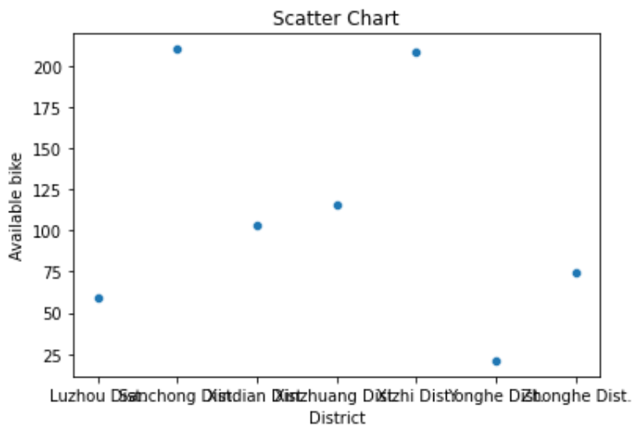
Results HW2
Scatterplot of New Taipei City’s bike dataset
District ： location= [i['sareaen'] for i in json_tree]
Available bike：availbike = np.array([int(i['tot'])for i in json_tree])-np.array([int(i['sbi'])for i in json_tree])

